Slide 1

Ansley Schug, Charles Kanoy, Jeremy Rylicki, Riley Abrahamson

Slide 2

Introduction
Team: Ansley Schug, Riley Abrahamson, Jeremy Rylicki, and Charles Kanoy
Company: Adventium Labs
Sponsor: Danielle Stewart
Stakeholder: U.S. Army
Notes:
Ansley

Slide 3

Company Overview - Adventium Labs
Based in Minneapolis, MN
Research and development in model-based system engineering
Develop solutions for safe and secure software-intensive complex systems
Partnership with various federal research and military departments
Notes:
Ansley

Slide 4
Company Overview - GUMBO Project
Overarching Project:
Grand Unified Modeling of Behavioral Operators (GUMBO)
Goal is to unify a cross-section of behavior representations in AADL to support unified behavioral analysis
Our Job:
Create a plugin for the OSATE environment that translates FACE models to AADL documents in the AGREE format.
Plugin consists of UI for system engineers to determine and set specific parameters and limitations to FACE models
Notes:
Ansley
Other things to say about GUMBO:
Verify that behaviors defined across different annexes are compatible in the modeled system
Support other modeling approaches (e.g., SysML).

Slide 5
Grand Unified Modeling of Behavioral Operators (GUMBO)
OSATE is an Eclipse-based IDE for AADL modeling
AADL is used for modeling software and hardware systems
FACE is a model to describe system architectures
AGREE is used to model assumptions and guarantees for AADL models
OSATE includes a plugin that translates FACE models to AADL
Our Job:
Create an OSATE plugin that reads an AADL instance model and translates it to an AGREE model
Create UI for system engineers to determine set specific parameters and limitations to FACE models
Notes:
Ansley

Slide 6
Need, Problem, Opportunity
FACE models do not include constraints
AGREE models require assertions
Assumptions
Guarantees
Users of GUMBO need AGREE constraints
Ease of use
Risk reduction
UI must be efficient otherwise developers won’t use it
Notes:
Chuck
Constraints are needed for complex systems
Assertions include needed constraints as assertions
An easy to use UI that automatically generates AGREE constraints improves performance of complex systems

Slide 7
Solution
Generate assertions
Requirements:
User interface constraint generation
AADL file iteration
Store previously used assumptions and guarantees
Simple interface
Three pages
Easy add and delete design
Notes:
Chuck

Slide 8
Solution
UI Constraint Generation
Automatic presentation of variables for constraints
Assumption, guarantee, and output pages
Error reduction through finite options
Storage of previous assertions
AADL File Iteration
Access data of selected AADL file
Gather information about components
Store information in an object
Notes:
Chuck
UI Constraint Generation
Information taken from back end will be used to present variables for constraint generation
Assumption and guarantee pages will be similar and output page will be used for putting AGREE model into the AADL file
Listing variables rather than having a user fill them in reduces variability of user input, thus reducing likelihood of error
Previously generated assertions will be stored in a JSON file for future reference if necessary
AADL File Iteration
Selected AADL files hold a lot of information in an object that can help with assertion generation ready to be parsed
Components meaning components, subcomponents, features (inputs and outputs), ports, and previous annexes
Translating the AADL file object data into something that is easier for us to work with is helpful

Slide 9
Meeting Schedule
Aside from class time:
Tuesdays at 12:45pm: Team meeting
Go over current contribution of each member and next steps
Thursdays at 12:45pm: Team meeting with sponsor
Go over examples and present our current team progress to our sponsor, asking questions as needed
Any other communication occurs through Slack as needed
Notes:
-Jeremy

Slide 10
Sprint Schedule
Sprint 1:
Install OSATE environment with AADL, FACE, and AGREE support plug-ins
Develop a web prototype of the plug-in for demonstration purposes
Sprint 2:
Develop an initial version of the plug-in with full constraint adding functionality
Test for accuracy of the ports, connections, systems, and features
Simplify the UI
Sprint 3:
Constrain user input to reduce syntax errors
Polish UI field - instructions are clear
Sprint 4:
Improve time efficiency of the algorithm.
Packaging the plugin
Create documentation to assist future users
Notes:
-Jeremy

Slide 11
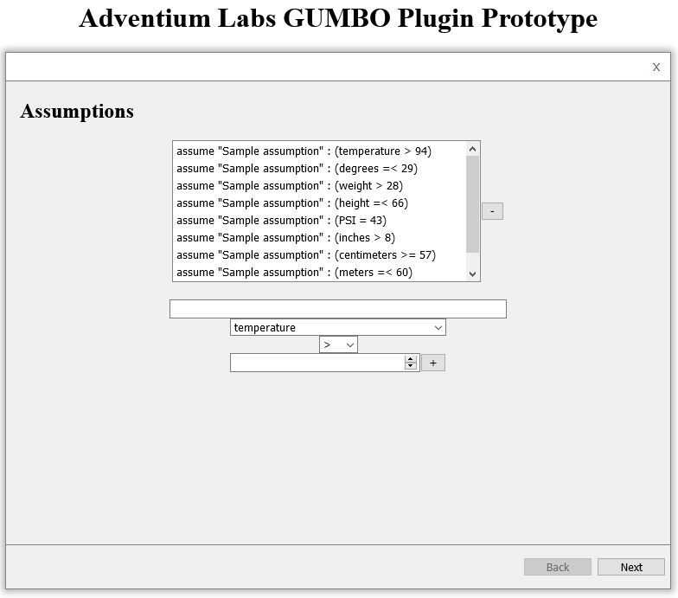
UI Prototype
A UI Prototype was built prior to plugin coding
It was developed as a web app
Created with React
Hosted on Netlify
Went through two rounds of revision with Adventium system engineers
Live link is available at: https://adventium-gumbo-ui-prototype.netlify.app/
Notes:
Riley

Slide 12

Product Demo
Demo in OSATE
Notes:
Riley

Slide 13
Issues/Risks
Eclipse dev environments breaking
Breaking down the project
User Interface
File Iteration
Storage
Packaging and Finalization
Creating a visually pleasing UI within the Swing framework
OSATE IDE & Instability
Notes:
Riley

Slide 14
Postmortem Summary
Hours Worked: 154
Lines of code: 2200
Hours Spent:
Learning Eclipse environment, AADL, and AGREE : 10%
Designing: 10%
Iteration: 20%
UI: 20%
Storage: 20%
Packaging: 20%
Notes:
-Jeremy

Slide 15
Next Steps
Developers at Adventium use this plug-in to create AGREE annexes for AADL models
Code is clean and organized so that Adventium can modify or add necessary changes in the future
Plug-in can be used by other organizations to create AGREE annexes
Notes:
-Jeremy

